Slide 1
Agenda
9:00 – 9:50 | Introduction to MVC
10:00 – 10:50 | Data
11:00 – 11:45 | Labs
11:45 – 12:45 | Lunch
12:45 – 13:30 | Forms and validation
13:45 – 14:45 | Advanced
14:45 – 15:30 | Labs

Slide 2

Hitting the wall
Notes:
http://www.flickr.com/photos/fixe/3685638408/sizes/o/

Slide 3
Topics
jQuery with ASP.NET MVC
Fundamentals
Microsoft Contributions
jQuery Templating
Introduction to TDD
Component strategies
Partials and Actions
Portable Areas
Community resources
Notes:
Estimated Time: 1 minute
In this section we will explore how ASP.NET MVC and Visual Studio 2010 have been improved to work really well with JavaScript. We also will cover some of the fundamentals of jQuery and why it’s such a powerful JavaScript library that we recommend you use in your web applications. Also we’ll discuss how Microsoft is now contributing to the jQuery project and some of the exciting new features you can expect to see in the coming months as part of this effort.

Slide 4
ASP.NET and JavaScript
Ajax Control Toolkit
Large range of JavaScript rich controls for Web Forms developers.
No need to write JavaScript
jQuery
Powerful way to build rich JavaScript web applications
Extensible plugin model
Notes:
Estimated Time: 2 minute
Talking Points:
Ajax Control Toolkit
40 Web Forms controls
Why invest in the Ajax Control Toolkit?
Used by over a million developers
Over 100,000 downloads a month
Open source project
Microsoft fixing top 25 issues every quarter based on forums
Accepting patches from the community

Slide 5
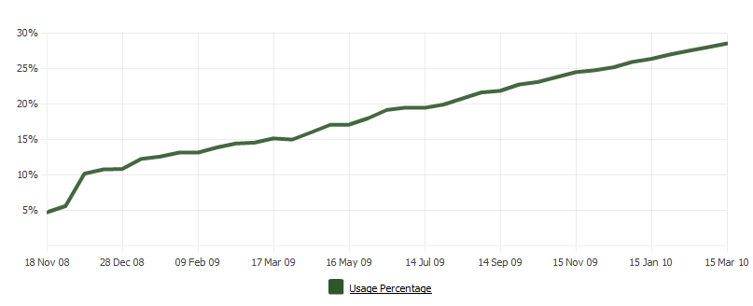
jQuery
The world’s most popular JavaScript library
From http://trends.builtwith.com/javascript/JQuery for March 15, 2010
Notes:
Estimated Time: 1 minute

Slide 6
jQuery – why so popular?
Easy to learn
Loads of Plugins
Powerful DOM Selection
Lightweight
Notes:
Estimated Time: 1 minute
Talking Points:
Easy to learn – fluent programming style,
Easy to extend – You create new jQuery plugins by creating new JavaScript functions.
Powerful DOM Selection – powered by CSS 3.0
Lightweight – Only 15 KB.

Slide 7
jQuery Fundamentals
Find Something
Do Something
$(“#something”).hide();
<div id=“something”></div>

Slide 8
Microsoft Contributing to jQuery
jQuery Core
Cool stuff ++
Open, transparent and collaborative
In the spirit of jQuery community
Specification, Proposals on jQuery Forums
Prototypes as Plugins in Github
Cool Stuff = Templating, Script Loader, Data-linking
Core Team
Proposal, Specification,
Prototype
ASP.NET Ajax Library
Cool Stuff
jQuery Plugins
Cool stuff
Notes:
Estimated Time: 4 minute

Slide 9
Template Syntax
<script id=“myTemplate" type="text/html">
<li>${ dataItem }</li>
</script>

Slide 10
.render()
<script id=“myTemplate" type="text/html">
<li>${ dataItem }</li>
</script>
$("#myTemplate")
.render( arrayOfDataObjects )
.appendTo("ul");
<ul>
<li>foo_0</li>
<li>foo_1</li>
</ul>

Slide 11
jQuery Demo
ASP.NET and JavaScript
jQuery
Top features
Templating
Notes:
Estimated Time: 2 minutes

Slide 12
TDD
Ignore the “religious” stuff, it’s a coding tool
It’s a good practice
It’s not hard to get started
Mocking
TDD and MVC

Slide 13
TDD Demo
Built-in tests in a new MVC App
Fakes
IndexAction_With_Search_Term_Should_Filter
Mocking with Moq
EditAction_Should_Return_View_For_ValidDinner
CreateDinnersControllerAs

Slide 14
Component Strategies
RenderPartial
RenderAction
Portable Areas

Slide 15
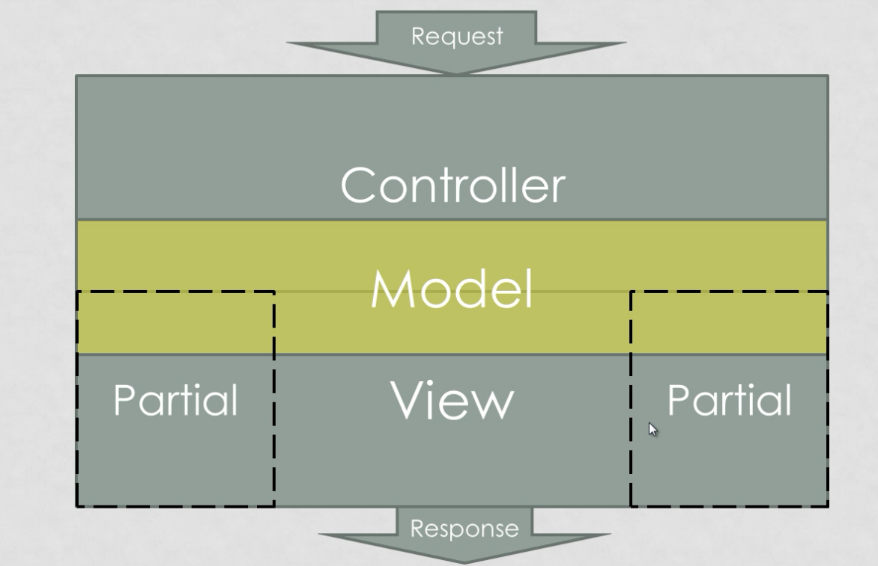

Slide 16
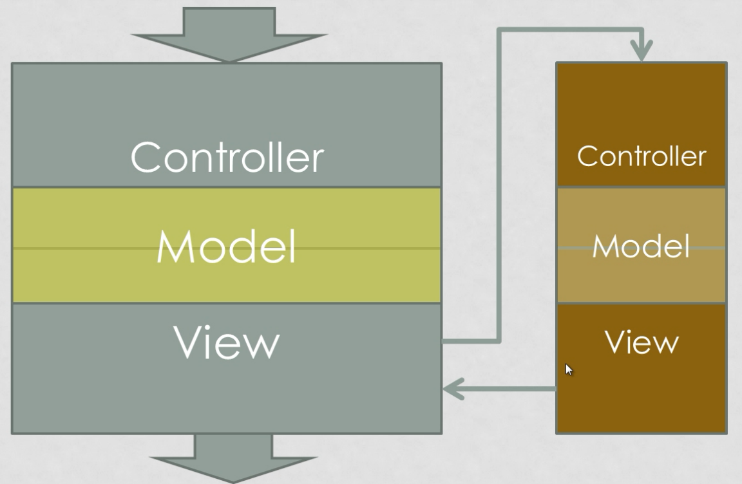

Slide 17
Component Strategies Demos
RenderPartial
Plan My Night / Views / Home / Index.aspx
RenderAction
Plan My Night / Views / Home / ActivitiesSearchResults.ascx
Portable Areas
OpenID Portable Area

Slide 18
MvcContrib – Grid Demo

Slide 19
Resources
http://asp.net/mvc
http://aspnet.codeplex.com/
http://c4mvc.net
http://mvccontrib.codeplex.com
http://stackoverflow.com

Slide 20
ActionResults
ContentResult
ViewResult
RedirectResult
JsonResult
FileResult
Make your own!
RSS Result
iCal Result

